Slide 1
putting reason
back into handlers
^{EZ}2USE
♻
90%
now with up to
37% shorter* proofs
*Findings based on a survey of 2 proofs conducted today

Slide 2
every computation
either
returns a value
or
calls an operation

Slide 3
let divide m n =
beep (); m / n
in
let x = choose 42 12 in
if x > 20 then
divide x 6
else
divide x (choose 0 4)

Slide 4
choose
beep
choose
7
beep
beep
let divide m n =
beep (); m / n
in
let x = choose 42 12 in
if x > 20 then
divide x 6
else
divide x (choose 0 4)
3
fail

Slide 5
choose
beep
choose
7
beep
beep
let divide m n =
beep (); m / n
in
let x = choose 42 12 in
if x > 20 then
divide x 6
else
divide x (choose 0 4)
3
fail

Slide 6
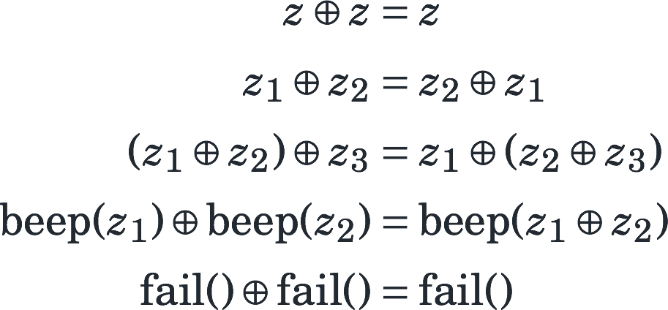
signature
equational theory

Slide 7
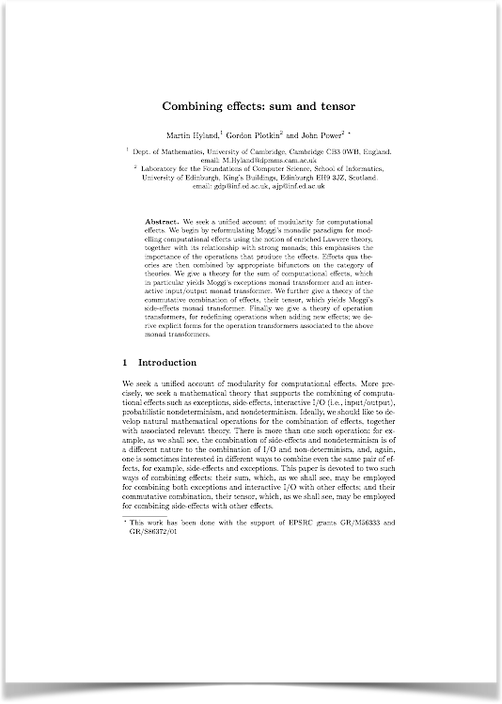

Slide 8
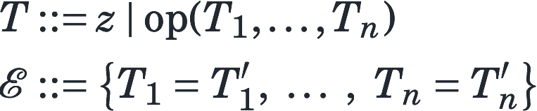
signature
equational theory

Slide 9

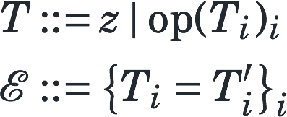
signature
equational theory

Slide 10
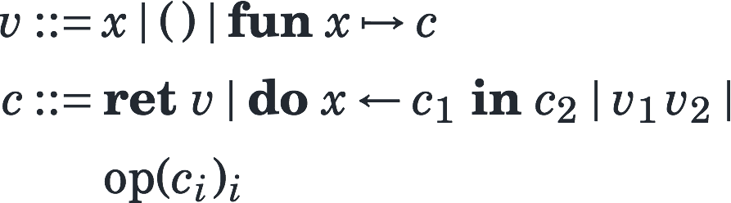
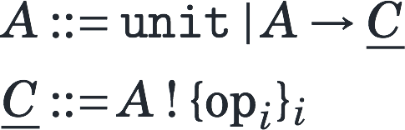
values
computations
value types
computation types

Slide 11
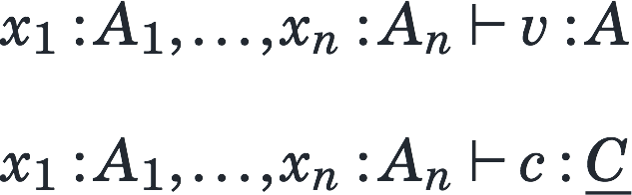
value typing
computation typing

Slide 12
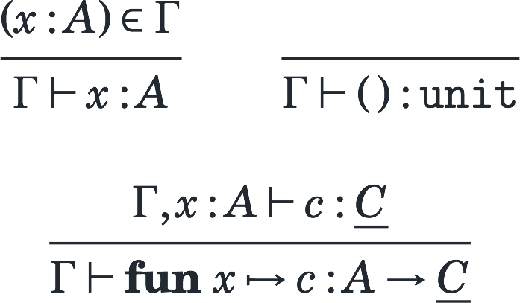

Slide 13
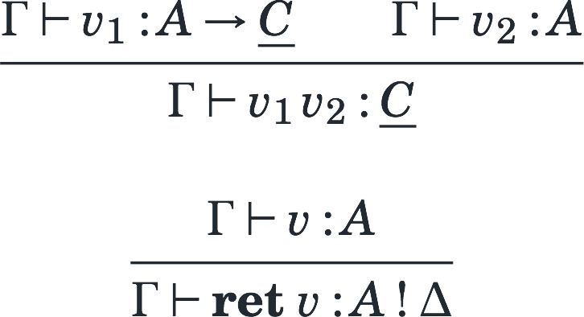

Slide 14
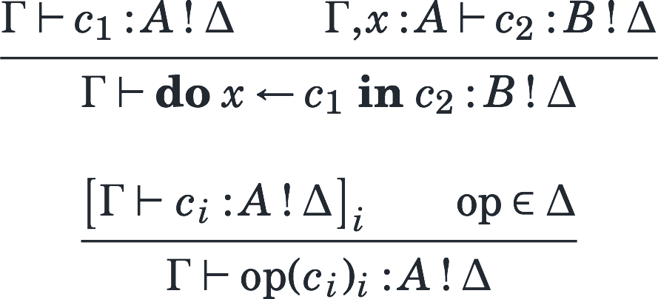

Slide 15
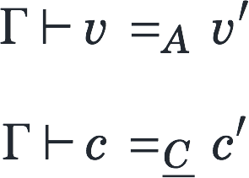

Slide 16
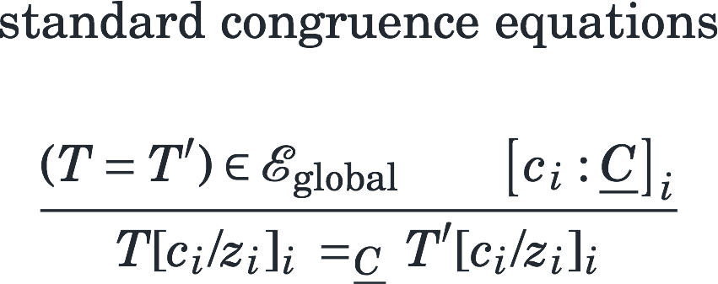

Slide 17
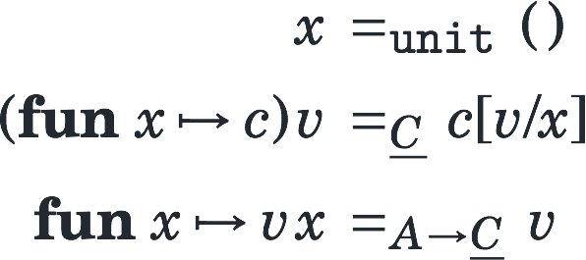

Slide 18
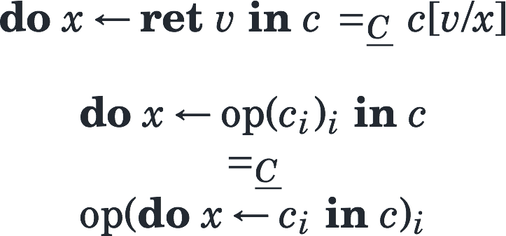

Slide 19
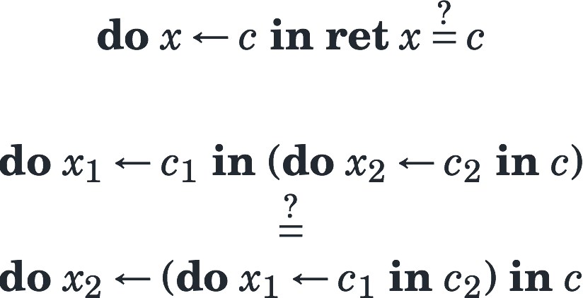

Slide 20
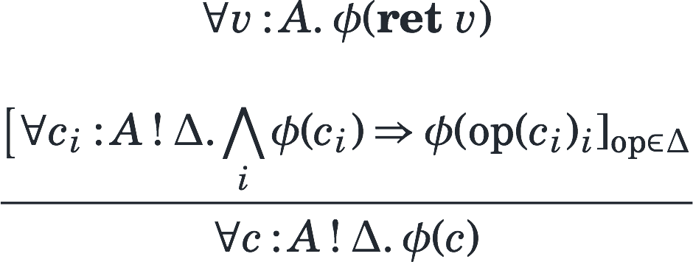
base case
operation cases

Slide 21
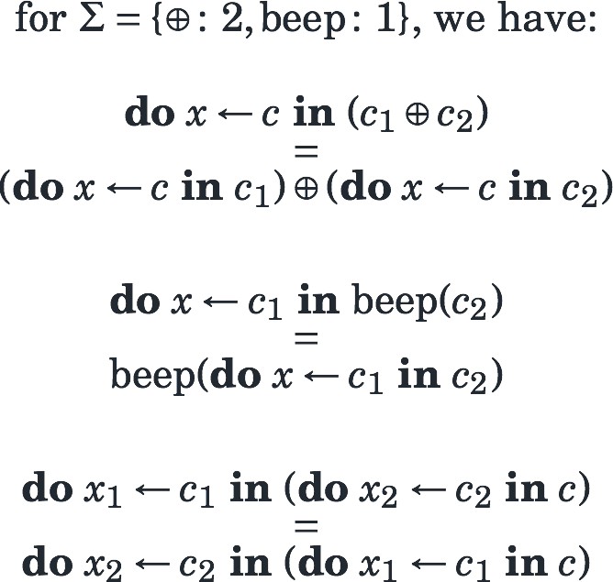

Slide 22
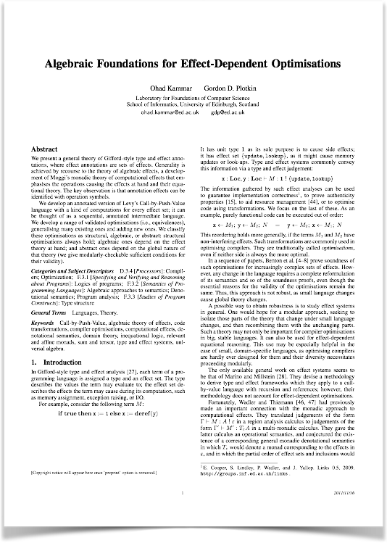

Slide 23
Let me
handle this!

Slide 24
choose
beep
choose
let divide m n =
beep (); m / n
in
let x = choose 42 12 in
if x > 20 then
divide x 6
else
divide x (choose 0 4)
7
beep
beep
fail
3

Slide 25
let goLeft = handler
choose k1 k2 -> k1 ()
in
with goLeft handle
choose
beep
choose
let divide m n =
beep (); m / n
in
let x = choose 42 12 in
if x > 20 then
divide x 6
else
divide x (choose 0 4)
7
beep
beep
fail
3

Slide 26
let goRight = handler
choose k1 k2 -> k2 ()
in
with goRight handle
choose
beep
choose
let divide m n =
beep (); m / n
in
let x = choose 42 12 in
if x > 20 then
divide x 6
else
divide x (choose 0 4)
7
beep
beep
fail
3

Slide 27
let random = handler
choose k1 k2 ->
if randomFloat () > 0.5
then k1 ()
else k2 ()
in
with random handle
choose
beep
choose
let divide m n =
beep (); m / n
in
let x = choose 42 12 in
if x > 20 then
divide x 6
else
divide x (choose 0 4)
7
beep
beep
beep
fail
3
fail

Slide 28
let random = handler
choose k1 k2 ->
if randomFloat () > 0.5
then k1 ()
else k2 ()
in
with random handle
choose
beep
choose
let divide m n =
beep (); m / n
in
let x = choose 42 12 in
if x > 20 then
divide x 6
else
divide x (choose 0 4)
7
beep
beep
fail
3

Slide 29
let random = handler
choose k1 k2 ->
if randomFloat () > 0.5
then k1 ()
else k2 ()
in
with random handle
choose
beep
choose
let divide m n =
beep (); m / n
in
let x = choose 42 12 in
if x > 20 then
divide x 6
else
divide x (choose 0 4)
7
beep
beep
fail
3

Slide 30
let random = handler
choose k1 k2 ->
if randomFloat () > 0.5
then k1 ()
else k2 ()
in
with random handle
choose
beep
choose
let divide m n =
beep (); m / n
in
let x = choose 42 12 in
if x > 20 then
divide x 6
else
divide x (choose 0 4)
7
beep
beep
fail
3

Slide 31
let pickMax = handler
choose k1 k2 ->
max (k1 ()) (k2 ())
in
with pickMax handle
choose
beep
choose
let divide m n =
beep (); m / n
in
let x = choose 42 12 in
if x > 20 then
divide x 6
else
divide x (choose 0 4)
7
beep
beep
fail
3

Slide 32
let pickMax = handler
choose k1 k2 ->
max (k1 ()) (k2 ())
fail -> -inf
in
with pickMax handle
7
choose
beep
3
choose
let divide m n =
beep (); m / n
in
let x = choose 42 12 in
if x > 20 then
divide x 6
else
divide x (choose 0 4)
7
beep
beep
fail
-∞
3

Slide 33
let toList = handler
choose k1 k2 ->
k1 () ++ k2 ()
fail -> []
beep k -> k ()
ret x -> [x]
in
with toList handle
[3, 7]
choose
beep
[3]
choose
let divide m n =
beep (); m / n
in
let x = choose 42 12 in
if x > 20 then
divide x 6
else
divide x (choose 0 4)
[7]
beep
beep
fail
[ ]
[3]

Slide 34
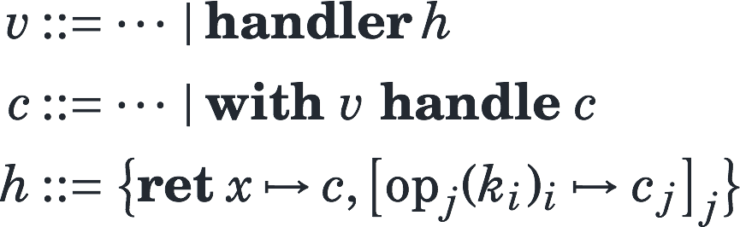
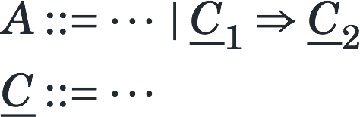
values & computations
handlers
value types
computation types

Slide 35
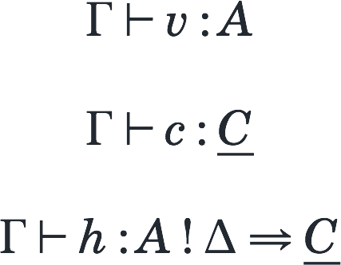
value & computation typing
handler typing

Slide 36
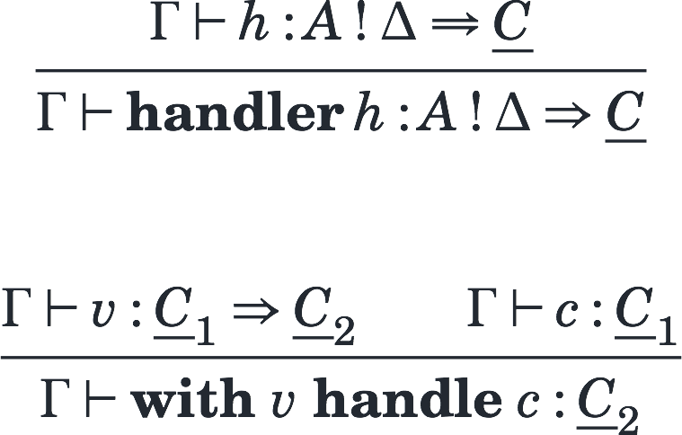

Slide 37
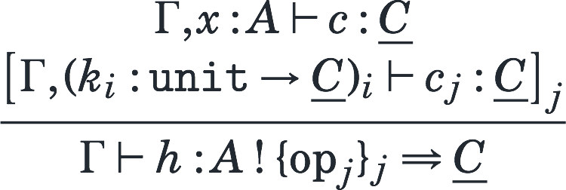

Slide 38
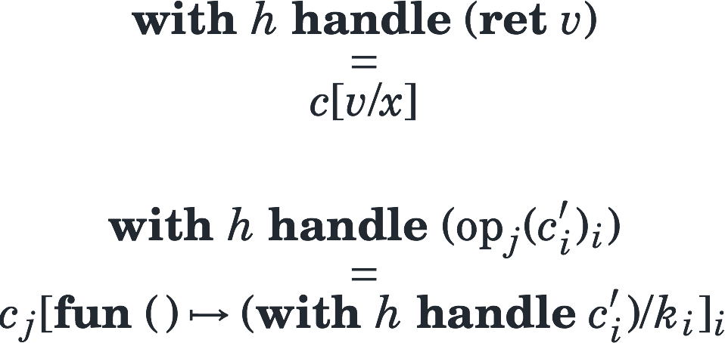

Slide 39
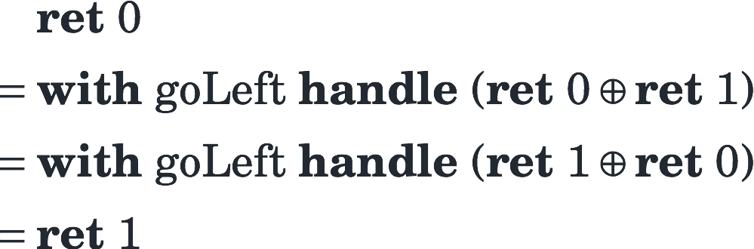
💩

Slide 40
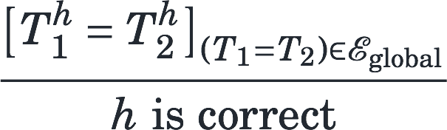

Slide 41
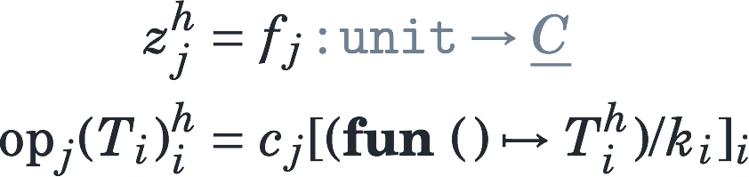

Slide 42




 | goLeft goRight | random | pickMax | toList | toSet
 | ✔ | ✔ | ✔ | ✘ | ✔
 | ✘ | ✔ | ✔ | ✘ | ✔
 | ✔ | ✘ | ✔ | ✔ | ✔
 | ✔ | ✔ | ✘ | ✘ | ✘
 | ✔ | ✔ | ✔ | ✔ | ✔

Slide 43
signature
equational theory

Slide 44
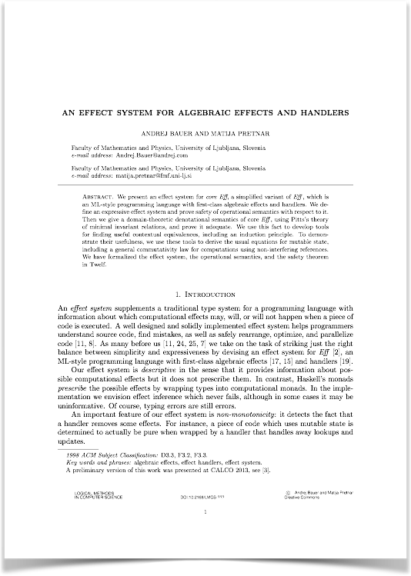
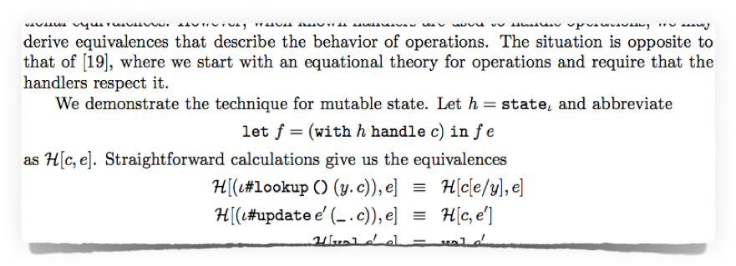

Slide 45
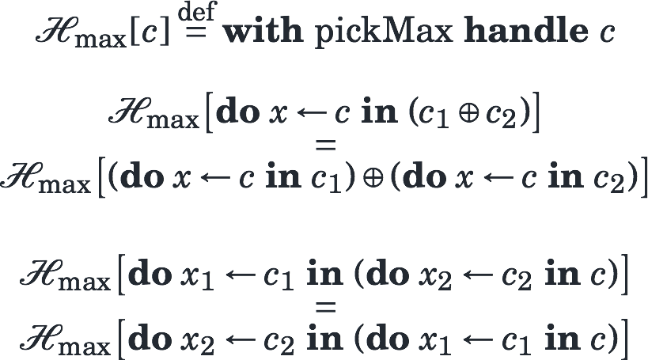

Slide 46
make EQUATIONS
GREAT AGAIN!
#mega

Slide 47
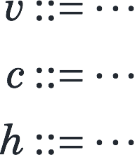
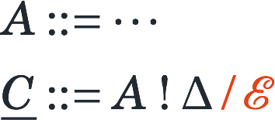
values & computations
handlers
value types
computation types

Slide 49
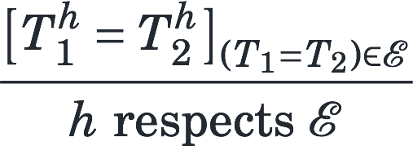

Slide 50
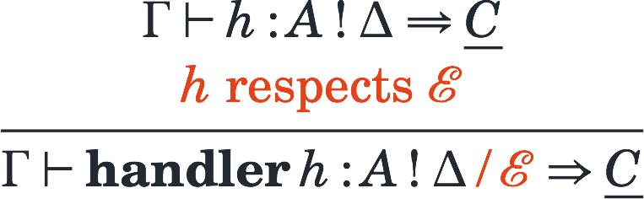

Slide 51
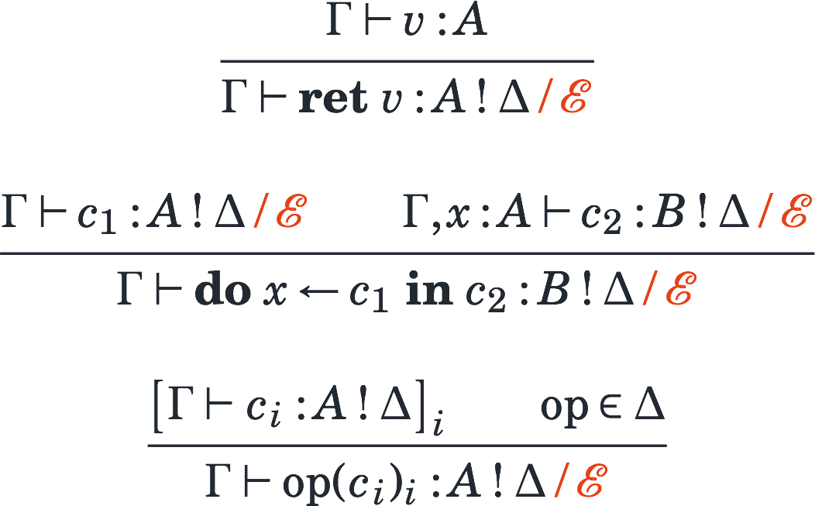

Slide 52
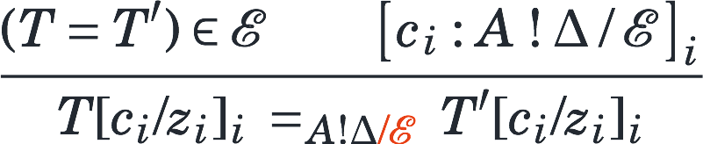

Slide 53
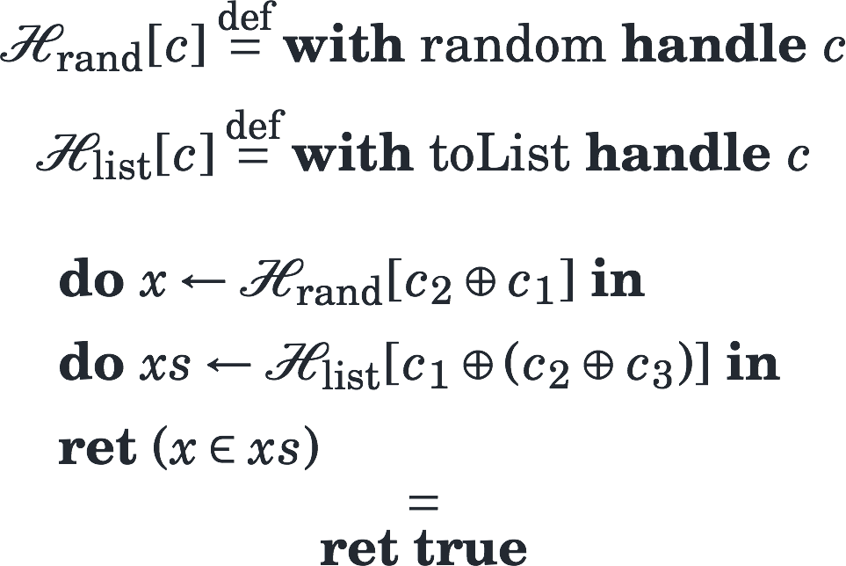

Slide 54
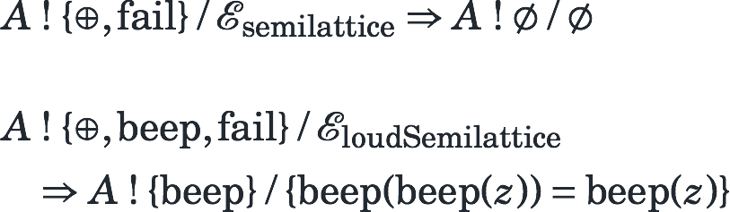
let pickMax = handler
choose k1 k2 ->
max (k1 ()) (k2 ())
fail -> -inf

Slide 55
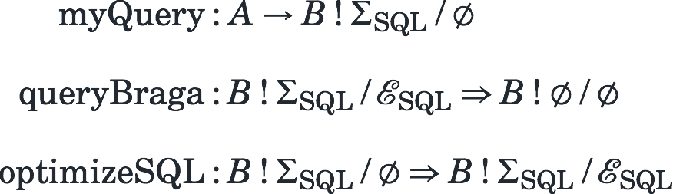

Slide 56
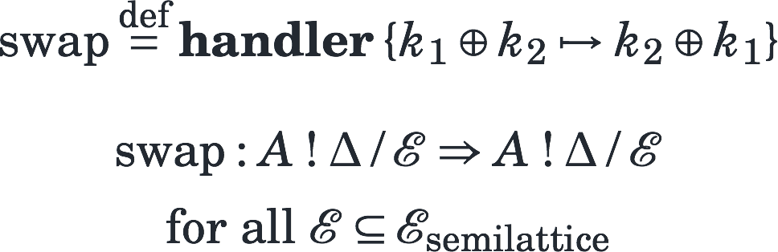

Slide 57
FUTURE WORK
usual suspects
semantics
safety
soundness
useful implementation
QuickCheck / QuickSpec
compiler optimizations
powerful logic
extended reasoning
more powerful specification

